Slide 1
PROJECT ON AIRLINE RESERVATION MANAGEMENT SYSTEM
Supriya SN
2021-6141
EBEON0921441677

Slide 2
CONTENTS
Introduction
Requirements
Problem Statement
Advantages
Project Output
Conclusion

Slide 3
INTODUCTION
Airline Reservation System are system that allow an airline to sell their seats.
It contains information on book flight, flight checking and contains passenger records.
Airline reservation systems incorporate airline schedules,fare,passenger reservation and ticket records.

Slide 4
REQUIREMENTS
Software Requirement Specifications
Operating System Front End Back End Server Documentation: Windows 10
Frontend Software : Java Eclipse: JDK
Backend Software : MySQL.
Hardware Requirement Specifications
Computer Processor Core i5 Processor Speed 4.4 GHz Processor Hard Disk 512 GB or more RAM Min 8GB

Slide 5
PROBLEM STATEMENT
The project is to design and implement the software which helps the Airline System employees to issue reservation tickets for various Air flights and maintain the records of various passengers and provide quick services to the passengers.

Slide 6
MODULES
Registration
Login
Flight Searching
Flight Booking
Flight Checkin

Slide 7
ADVANTAGES
Easy to book tickets
Save time and money
Provides any information about flight
Mobile availability
Send automated tickets to customer by email
Customer support by calls and chats
Available for Domestic and International airlines

Slide 8
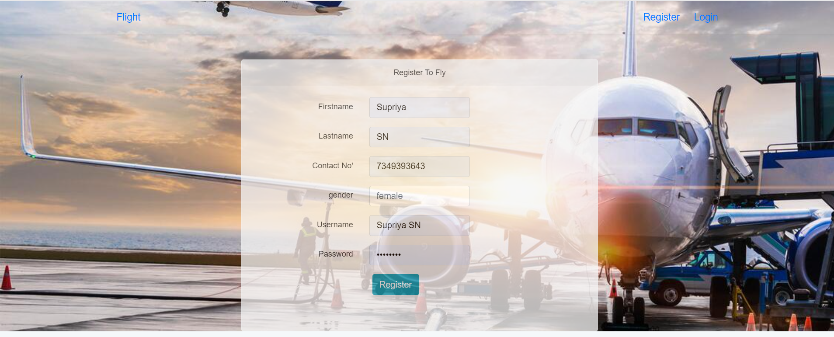
OUTPUT
Registration

Slide 9
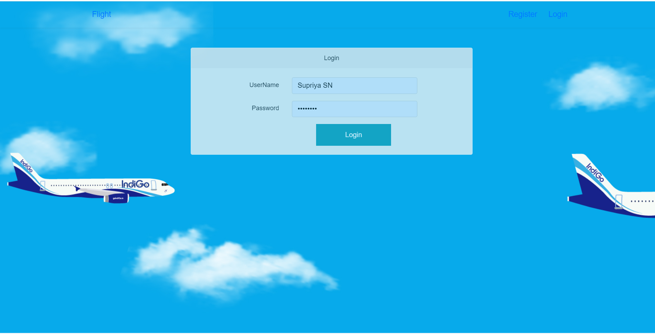
Login

Slide 10
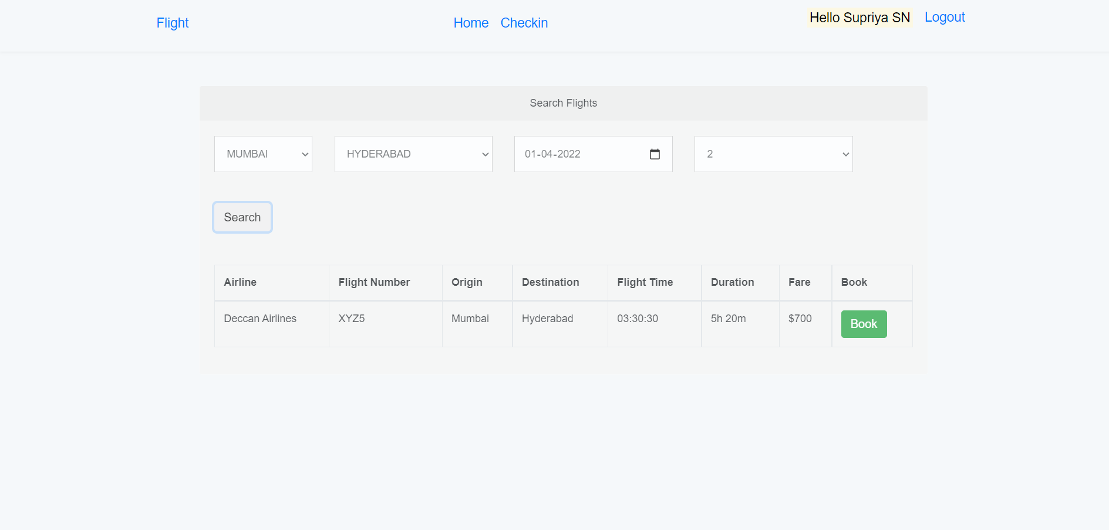
Search Flights

Slide 11
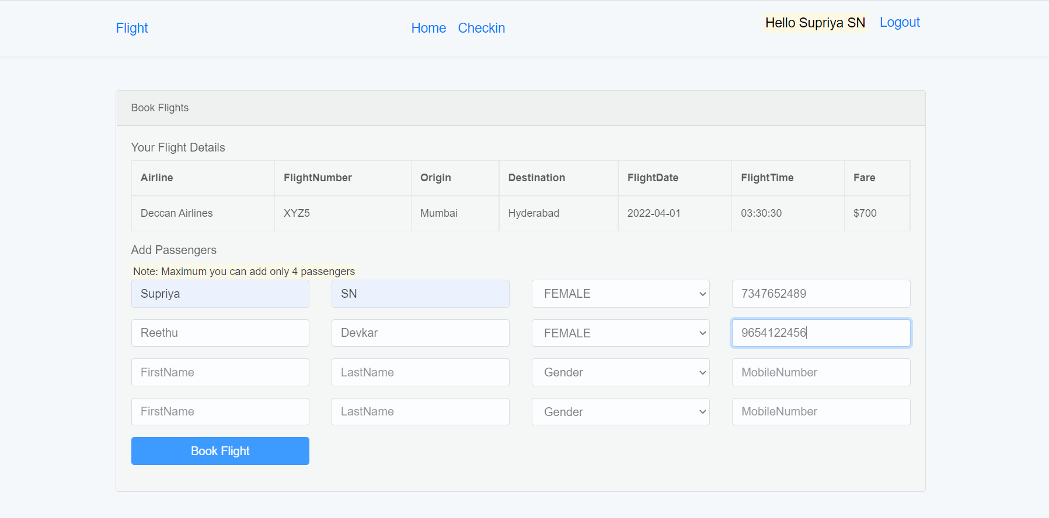
Book Flight

Slide 12
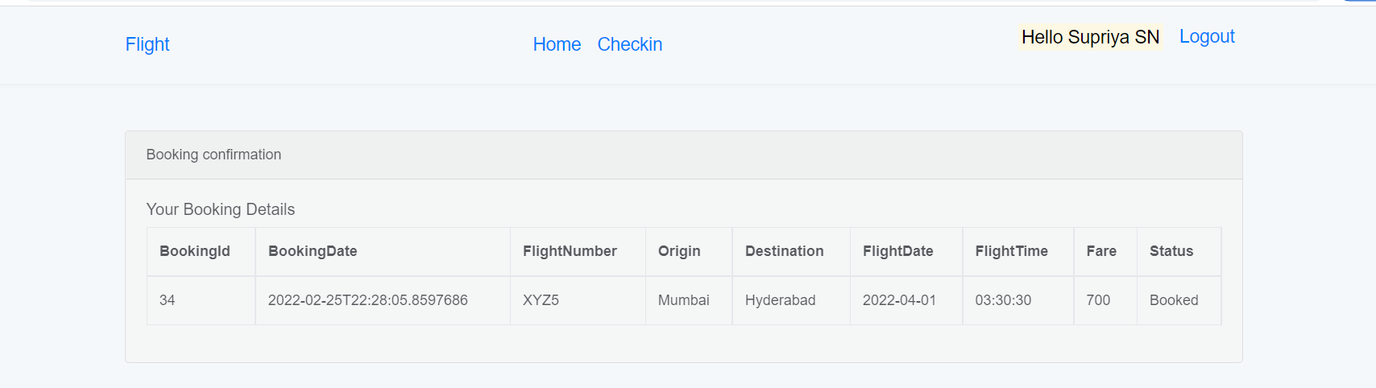
Booking Confirmation

Slide 13
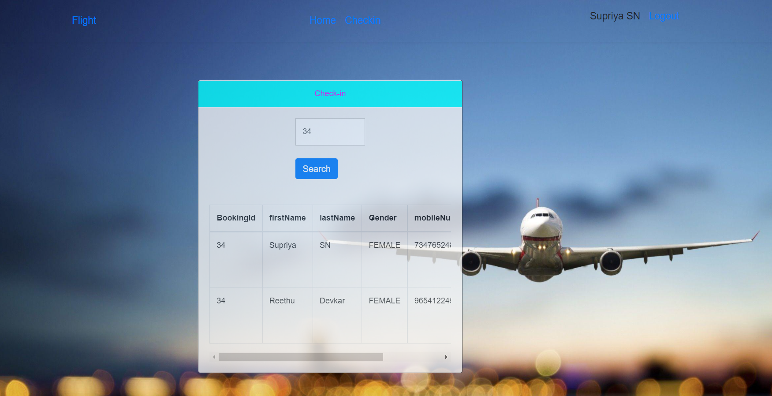
Checkin

Slide 14
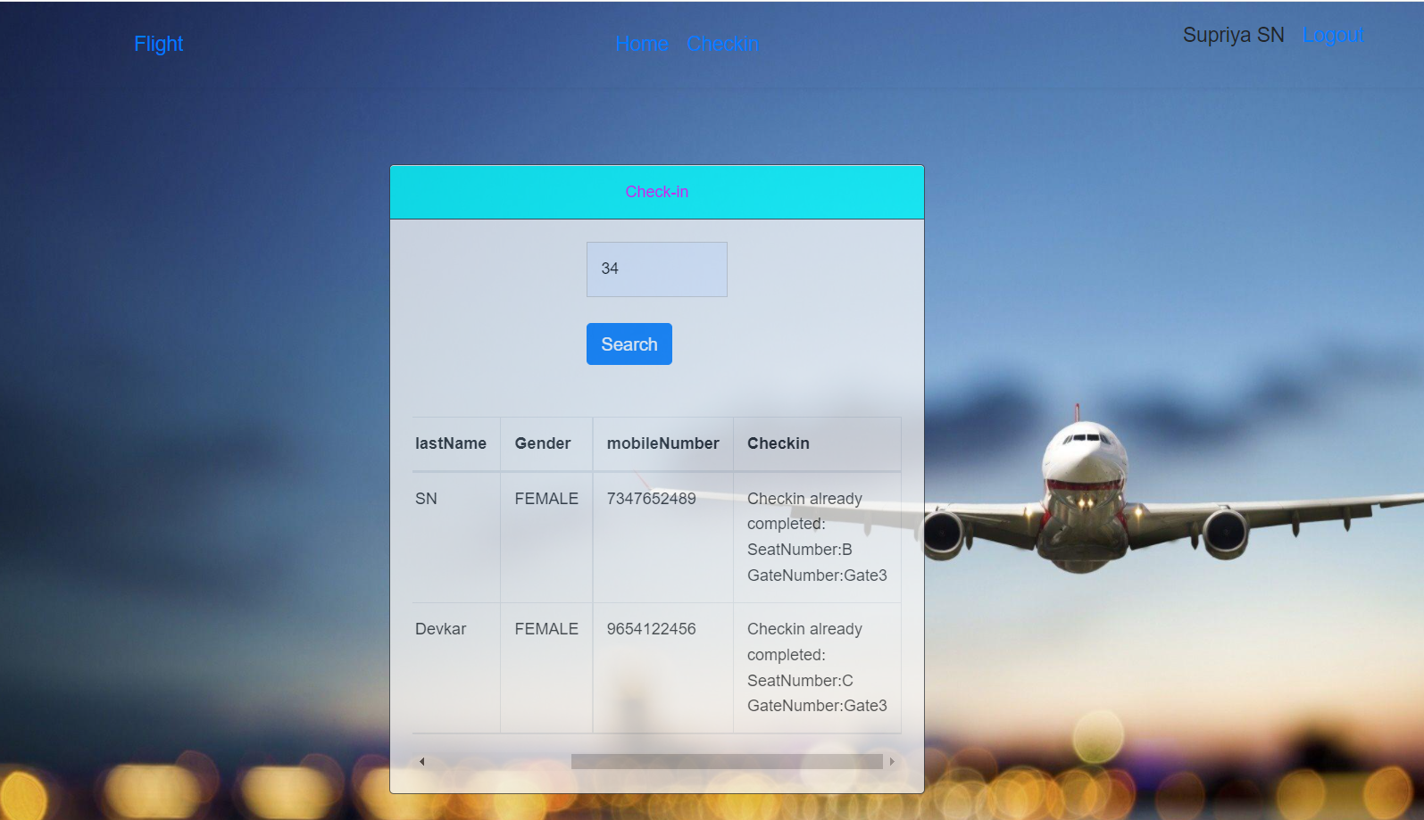
Checkin completed

Slide 15
CONCLUSION
This project on Airline Management System is the automation of registration process of airline system.
The system is able to provide much information like passenger’s details, flight details and the booking details.
This project has guided our path through various aspects of computer science where developing online application plays a major role.

Slide 16
THANK YOU

